Slide 1
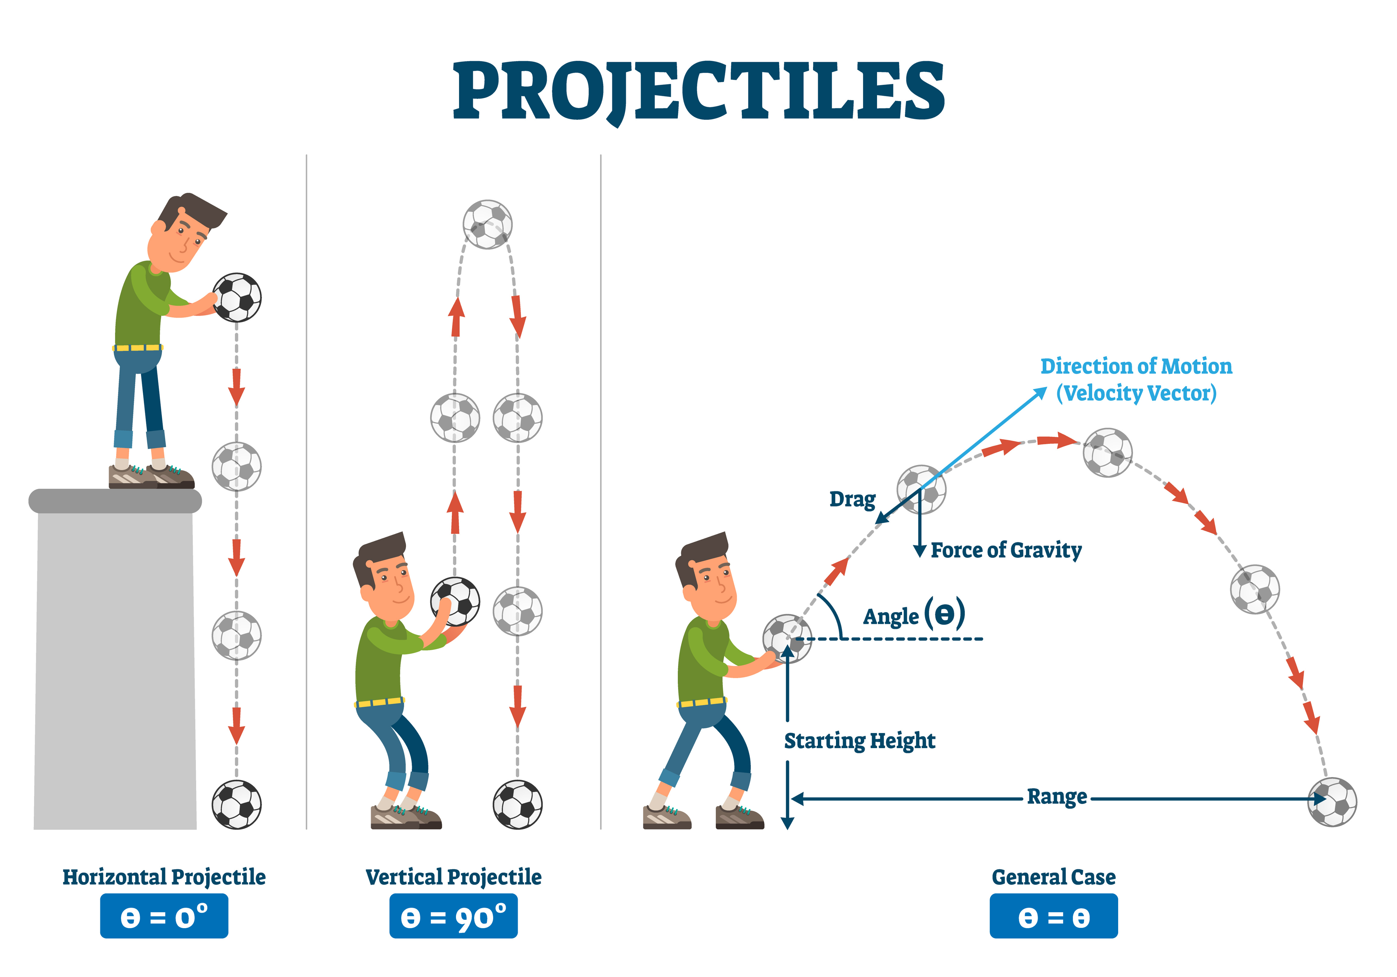
PROJECTILE AND MOTION IN 2-D
NJ-OER TOPIC-3

Slide 2
Learning Outcomes
Observe that motion in vertical direction on Earth Understand the independence of horizontal and vertical components in two-dimensional motion Understand the rules of vector addition and subtraction Apply graphical and analytical methods of vector addition Understand different vector representations and their relationship such as magnitude/angle; component form, graphical representation, vector representation Identify, explain and determine range, maximum height, time for fall, velocity and trajectory of a projectile. Apply the principle of independence of motion to solve general 2-D motion problems. Apply principles of vector addition to determine relative velocity and explain the significance of the observer.

Slide 3
Concepts
Δx = displacement in x Δy = displacement in y vo= initial velocity vox = initial velocity in x voy = initial velocity in y vfx =final velocity in x vfy = final velocity in x t = time or duration g= gravitational acceleration ax = acceleration in x ay = acceleration in y VAB=Velocity of object A with respect to observer B θ = angle measured from the +x-axis

Slide 4
Units
Position, displacement, distance are in meters “m” Velocity and speed are in meters per second “m/s” Acceleration is in meters per second square “m/s²” Angle in degrees or radian

Slide 5
Formulas
Δx = vox t + ½ ax t² vfx=vox + ax t vfx ² - vox² = 2ax Δxa vox = vo cos(θ) voy = vo sin(θ) ax = a cos(θ) ay = a sin(θ) v²= vx² + vy² a²= ax² + ay² tanθ= vy / vx | Δy= voyt + ½ ayt² vfy= voy+ ay t vfy² - voy ² = 2ayΔy Free fall or projectile vfx=vox ax=0 ay=-g g= 9.8 m/s² Relative velocity Vab = Vao + Vob

Slide 6
KEY STRATEGIES
Draw the motion diagram, identify given quantities and the unknown
For 2-D problems use trigonometry to identify components
Substitute the known quantities and solve for the unknown using algebra
Maximum height happens at the time when vfy=0. Set vfy to zero, solve for t
Time for the fall is calculated using y=0 or (yf-yi)=-(initial height)
Range is calculated in the x-axis at the time when y=0
Impact speed can be calculated using the timeless equation of kinematics
Released means vo=0

Slide 7
MODEL PROBLEM
Q) An object is projected upward from the ground with 15.0 m/s speed.
A) When will it reach the maximum height
B) What is the maximum height
C) If the object continues its motion after reaching the y-max, what is the impact velocity and what is the time for fall.
Notes:
SOLUTION A: Viy=+15 Vfy=0 g=9.8 t=? Vfy=Vi-gt t=1.53 s
SOLUTION B: deltaY= viy t –1/2gt^2 deltay = 11.5 meters
SOLUTION C: The motion is symmetric. Time to go up is equal to time to go down. Vfy=-15 m/s

Slide 8
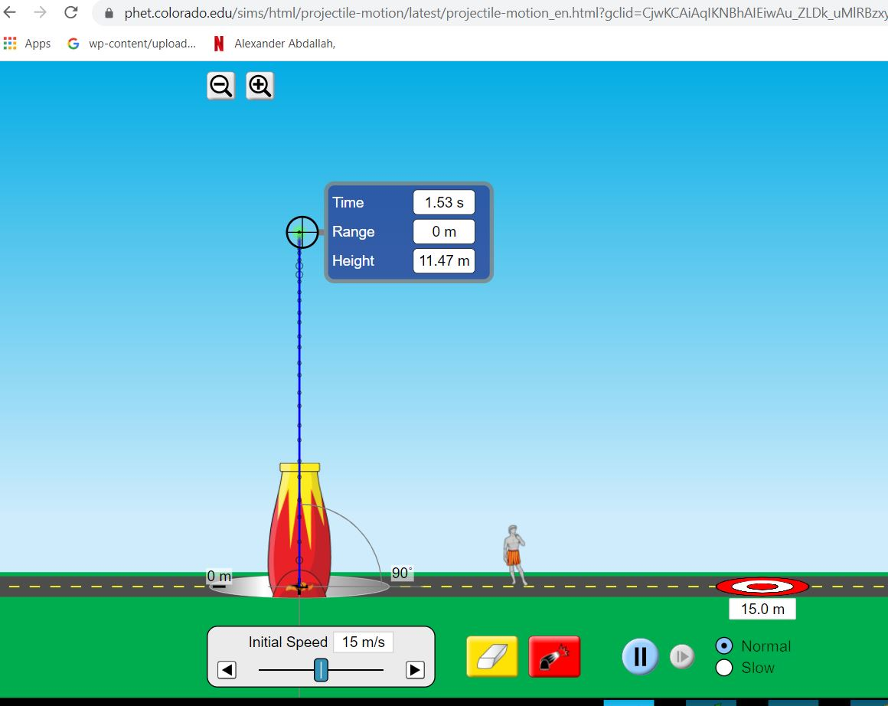
ACTIVITY PROJECTILE
Q) An object is projected upward from the ground with 15.0 m/s speed. A) When will it reach the maximum height? B) What is the maximum height?
This problem can be simulated using an online activity. Run the app, obtain the results from the app and compare it with your calculations.
Open Phet Projectile simulation https://phet.colorado.edu/en/simulations/projectile-motion
Choose intro or lab. Set the initial height to zero and initial speed to 15m/s.
Hit the red button and launch the projectile
Using the probe on the top right, next to the initial values, measure the maximum height and the time for the projectile to reach the maximum height. Compare it with your calculations

Slide 9
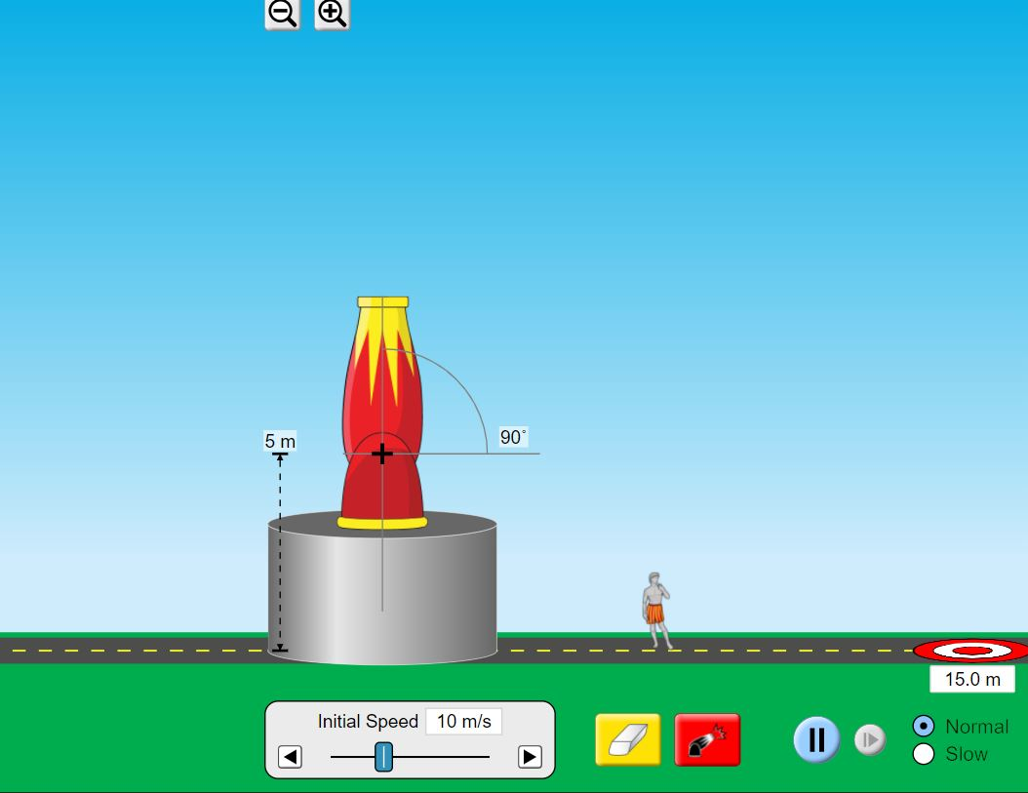
ACTIVITY PROJECTILE
Q) An object is projected upward with 10.0 m/s speed from 5 meters height. A) When will it reach the maximum height? B) What is the maximum height? C) Find the impact velocity using timeless equation of kinematics. Using Vfy equation find the total time for fall. D) Obtain the height at t=0.2s by substituting t=0.2 in Δy equation
Run the app, obtain the results from the app and compare it with your calculations.
IMPORTANT NOTES:
Kinematics equation gives ΔY. You need to add the initial height in order to find ymax
For the impact velocity, Vfy is always negative

Slide 10
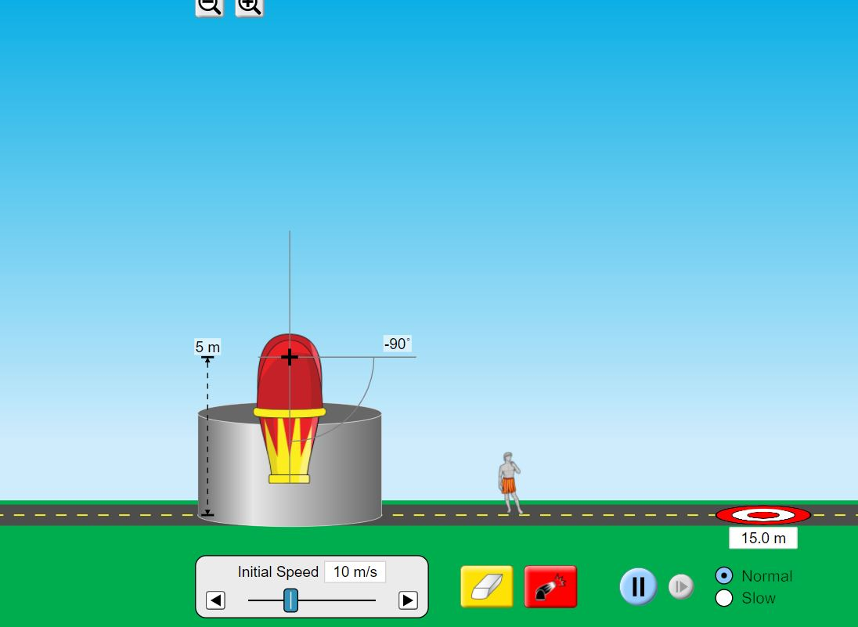
ACTIVITY DOWNWARD PROJECTILE
Q) An object is projected DOWNWARD with 10.0 m/s speed (viy=-10m/s) from 5 meters height. A) What is the maximum height? C) Find the impact velocity using timeless equation of kinematics. Using Vfy equation find the total time for fall. D) Obtain the height at t=0.2s by substituting t=0.2 in Δy equation
Run the app, obtain the results from the app and compare it with your calculations.
IMPORTANT NOTES:
For downward projectile, ymax is the original height
For all the downward projectile viy is negative. Slider tool gives the speed which is the magnitude.

Slide 11
ACTIVITY
Using the given initial values run the simulation. Obtain the results using the probe. Using equation of kinematics calculate the values and compare
Yi(m) | Viy(m/s) | Ymax(m) | Time for Ymax (s) | Time for fall (s) | Ymax (calculated) | Time for ymax (calculated) | Time for fall calculated(s)
5 | 9
6 | -8
0 | 10
11 | 0
11 | 2
11 | -2

Slide 12
REVERSE PROBLEMS, FINAL IS GIVEN INITIAL IS ASKED
Q) An object is projected upward from a tower. It reaches ymax=20 meters at t=2.0 seconds.
A) What was the initial velocity viy?
B) What was the initial height.
C) If it continues the motion, what would be the impact velocity, and time for fall
Do the same problem model using different given numbers
1) ymax = 20m t=1.5s Find Viy and the height
2) ymax = 10m t=2.5s Find Viy and the height (this is a projectile from a water well
3) ymax=? t=3 seconds h=12 meters find viy and ymax
Notes:
Solution
AT YMAX Vfy=0 Vfy=Viy –gt 0=Viy - (9.8)(2)=19.6 m/s
Deltay = Viy t –½ g t^2 = 19.6 meters. This is the motion from the original level.
Height must be 20-19.6=0.4 meters
Impact velocity can be calculated using Vfy^2 =Viy^2 -2g deltay Vfy=-19.4 m/s
Vfy = Viy-gt t=(Vfy-Viy)/(-2g) t=4 seconds.

Slide 13
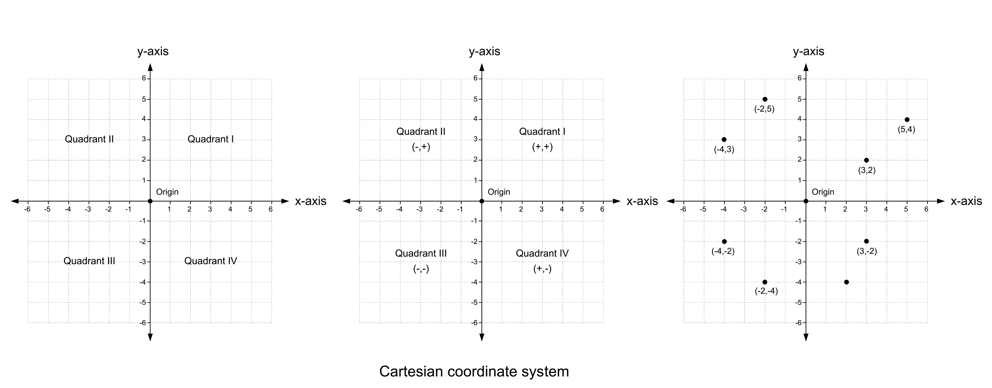
VECTOR REPRESENTATIONS 2-D Motion
Graphical Magnitude/Angle Components Vector Representation
3 units at 45 degrees Vx=3 cos45=2.1 units V=2.1 i + 2.1 j
Vy=3 sin45 =2.1 units
QUADRANTS AND DIRECTIONS
First quadrant both components +, second quadrant x component -
third quadrant both components -, fourth quadrant y component -

Slide 14
MODEL PROBLEMS
vx =v cos(θ) angle measured with respect to x-axis
vy=v sin(θ) angle measured with respect to x-axis
v=|v|=sqrt(vx² + vy²) Pythagorean Theorem
tanθ=vy/vx
𝜃=tan-1(vy/vx) or 𝜃=tan-1(vy/vx)+π based on quadrant
v= vx i + vy j
1) x-component of velocity is vx=3m/s and y component is vy=4m/s. Write the velocity as vector representation, in magnitude/angle form, and show it graphically
v= 3 i + 4 j V has a magnitude of 5m/s making 53degrees with the x-axis v
2) An object has an acceleration of 4.0 m/s^2 making –45 degrees with the x-axis. Find ax,ay. Show the vector
ax =a cos(θ) ay=a sin(θ) ax=2.3m/s^2 ay=-2.3 m/s^2 a

Slide 15
ACTIVITY VECTORS
One representation of an acceleration vector a is given. Find the other representations.
Choose a suitable scale for the graphical interpretation. For the last problem there are two solutions.
Magnitude Angle Form |  | Component Form |  | Vector Form | Graphical
Magnitude | Angle | ax | ay | ax i + ay j | Choose a scale. Show the arrow in the correct direction
15 | 53.1
 |  | -5 | -5
 |  |  |  |  | Two units to the West
 |  |  |  | 12i + 5j
5 |  | 3

Slide 16
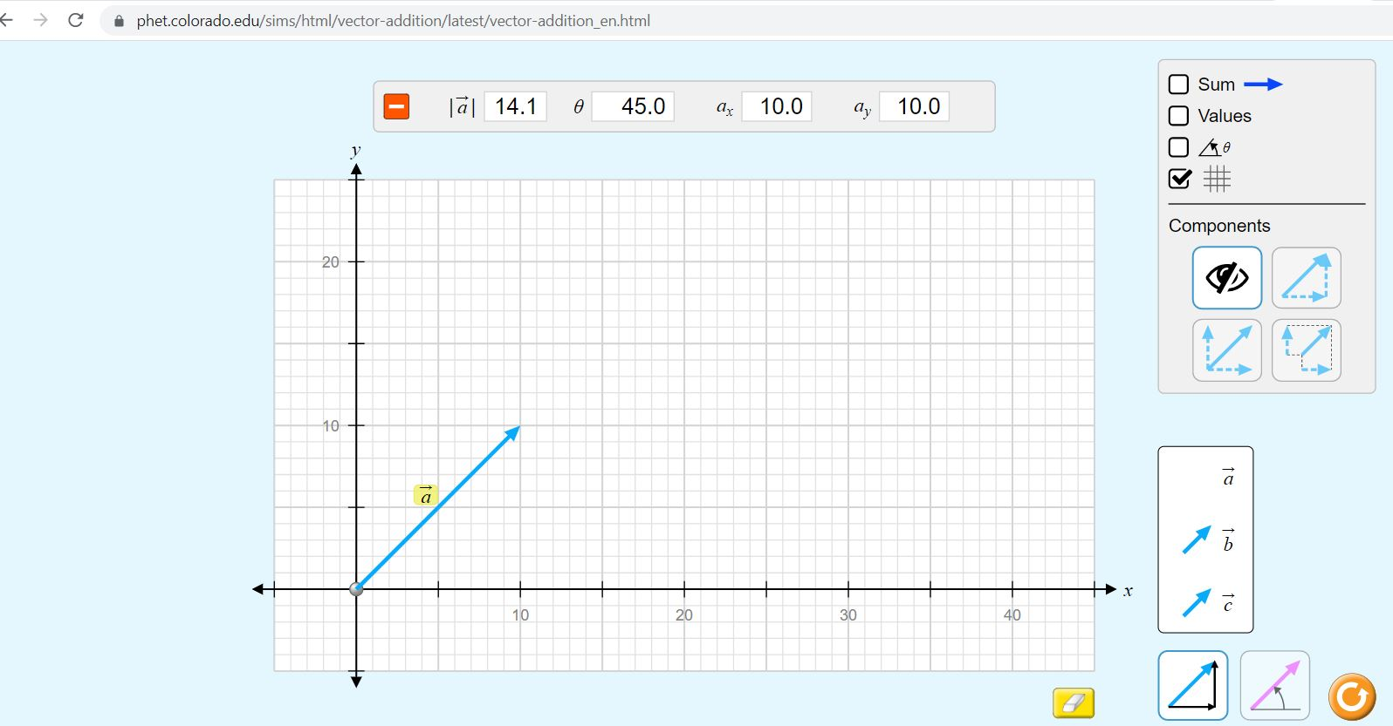
ACTIVITY VECTORS
Open https://phet.colorado.edu/en/simulations/vector-addition
Choose explore 2-D. Drag the vector "a" to the cartesian coordinates.
Explore the sign for the vector components in various quadrants by rotating or resizing the vector.

Slide 17
ACTIVITY VECTORS USING PHET
Go to https://phet.colorado.edu/en/simulations/vector-addition and choose explore 2-D
Drag the vector "a" and verify your answers
Come up with your own problems and explore
Magnitude Angle Form |  | Component Form |  | Vector Form | Graphical
Magnitude | Angle | ax | ay | ax i + ay j | Choose a scale Show the arrow
15 | 53.1
 |  | -5 | -5
 |  |  |  | 12i + 5j
5 |  | 3

Slide 18
2-D PROJECTILE Horizontal x-axis Vertical y-axis
Δy =voy t - ½ g t²
vfy=voy -gt
vfy² - voy ² = -2g𝛥y
Δx =vox t
vfx=vox
Three Cases
A) Horizontal projectile from a height, Voy=0
B) Diagonal projectile from the ground, Δy=0 at impact
C) Diagonal projectile from a height, general case

Slide 19
Model Problem Horizontal Projectile
Q) A piece of rock projected horizontally from a cliff. It stays in the air for 6.0 seconds before hitting the ground and travels a range of 288 meters measured from the bottom of the cliff. Neglect the friction.
What was the height it was projected from?
What was its initial velocity?
What is y-component of the final velocity at the impact.
Find the impact speed.
Notes:
Solution:𝛥y =-176 m h=176 m, vox =48 m/s, vfy=-58 m/s V=75m/s

Slide 20
Model Problem Diagonal Projectile
Q) A golf ball is hit from the ground with an angle of 30 degrees with the x-axis. Golf ball has an initial speed of 10.0 m/s.
What are the x and y components of initial velocity
How long will it stay in the air?
What is the range?
What is the impact speed?
Notes:
Solution: vox =8.7 m/s, voy=5.0 m/s t=2.0 seconds Range=17.7m v=10m/s

Slide 21
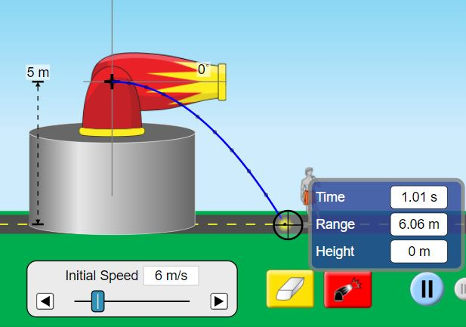
ACTIVITY 2-D HORIZONTAL PROJECTILE
Open https://phet.colorado.edu/en/simulations/projectile-motion
Drag the cannon up to the initial height
Rotate the cannon to zero degrees, adjust the speed
Q1) An object is projected horizontally from 5 meters
height with 6m/s speed
Calculate its location in x and y after 0.2 seconds
Using the height, calculate time for fall
Using the time and the initial speed calculate its range
Verify your values using the simulation
Repeat the activity for various heights and speed.

Slide 22
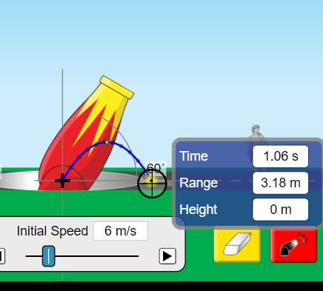
ACTIVITY 2-D DIAGONAL PROJECTILE
Open https://phet.colorado.edu/en/simulations/projectile-motion
Drag the cannon up to the initial height
Rotate the cannon to zero degrees, adjust the speed
Q1) An object is projected with 60 degrees angle diagonally from the ground. Initial speed is 6m/s
When will it reach the maximum height (Vfy=0)
What is the maximum height
Find the time for fall and the range
Verify your values using the simulation
Repeat the activity for various height, speed and angle.

Slide 23
General 2-D Motion
For motion on the surface of the Earth, we can take North as +y axis and East as +x axis. We treat the motion as if it is two separate motion
Δx = vox t + ½ ax t² vfx=vox + ax t vox = vo cos(θ) ax = a cos(θ)
Δy = voy t + ½ ay t² vfy=voy + ay t voy = vo sin(θ) ay = a sin(θ)
Q)A car is initially moving 37 degrees North of East with 20 m/s. It accelerates suddenly towards South with a=4m/s^2. Find ax.ay,vox and voy. Find the displacement in x,y and the final velocity components vfx and vfy in two seconds.
Notes:
Solution: ax=0 ay=4 Vox= 16m/s Voy=12m/s t=2
Δx=(16)(2)+0=32 meters Vfx= 16m/s
Δy= 12(2)-½ (4)(2^2)= 16 meters Vfy=12-4(2)=4m/s

Slide 24
Classwork-Complete the Table
Δx = vox t + ½ ax t² vfx=vox + ax t vox = vo cos(θ) ax = a cos(θ)
Δy = voy t + ½ ay t² vfy=voy + ay t voy = vo sin(θ) ay = a sin(θ)
Vo | a | t(s) | deltaX | deltaY | Vfx | Vfy
Vox=4m/s Voy=3m/s | ax=2m/s^2 ay=-1m/s^2 | 3
Speed 5m/s angle=30 | a= 4 m/s^2 West | 4
6 m/s North | 2 m/s^2 East | s
 | ax=2m/s^2 ay=-1m/s^2 | 6 |  |  | 15 m/s | 12 m/s
Vox= 20m/s Voy=15m/s |  | 8 | 120 meters | 140meters
Come up with your own questions. Make sure they are consistent and sufficient to solve

Slide 25
RELATIVE VELOCITY USING VECTOR ADDITION
A = Ax i + Ay j
B = Bx i + By j
A+B = (Ax+Bx) i + (Ay + By) j
A = 3 i – 4 j
B = 12 i + 14j
A+B=15 i + 10j

Slide 26
RELATIVE VELOCITY USING VECTOR ADDITION
Vab = Velocity of object a with respect to the observer at b
Vbc = Velocity of b with respect to the observer c
Vac = Velocity of object a with respect to the observer c
Vab = -Vba Vbc = -Vcb Vac = -Vca
For some problems we need to use the formulas above to match index
EQUATION: Vab + Vbc = Vac
REPEATED INDEX MUST BE ADJACENT

Slide 27
MODEL PROBLEM
1) Alex is swimming North with 2m/s speed with respect to Big Sur River.
The river is flowing with 3 m/s speed East with respect to Cathy who is observing Alex from the bank. What is the velocity of Alex with respect to Cathy. Vab=Velocity of Alex with respect to Big Sur River. Vbc= Velocity of Big Sur River with respect to Cathy. Vac=Velocity of Alex with respect to Cathy.
Vab = 2i + 0j
Vbc= 0i + 3j
Vac = 2i + 3j
Notes:
Cathy observes Alex swimming with 3.6 m/s speed towards NE about 33.7 degrees angle

Slide 28
Classwork
1) Vto = 4 i –5j Vqt = 3i+6 j Vqo=?
2) Velocity of an airplane with respect to the tower is 400mph 45º Northeast. Velocity of the wind with respect to tower is 30 mph East.
What is the velocity of the airplane with respect to the wind.
3) Vcb = 4j Vca=3 i –3j Find Vab
4) A swimmer wants to swim towards North with 2 m/s speed with respect to an observer on the bridge. River runs with 4 m/s towards west with respect to the bridge. What should be velocity of the swimmer with respect to the river
5) Vab= 3i Vac=5i +6j Find Vbc and Vcb

Slide 29
REFERENCES
Slide 1: Adobe id=296932788 Projectiles vector illustration. Labeled physical force trajectory scheme.
By VectorMine
Slide 13: Adobe id= 171841729 Cartesian coordinate system on white background vector illustration By attaphong
Slide 8-9-10-16-21-22 Screenshot from PhET Interactive Simulations University of Colorado Boulder https://phet.colorado.edu

